Slide 1
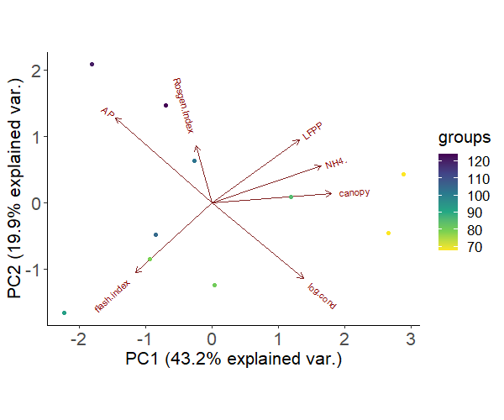
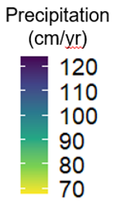
Precipitation
Low Flow
Pulse %
Rosgen Index
Precipitation
(cm/yr)
NH₄⁺
PC1 (19.9%)
Canopy
Flash Index
Conductivity
PC1 (43.2%)
Notes:
Figure 2: Principal Component Analysis of environmental predictors at 10 sites spanning a precipitation gradient along the Texas Coastal Prairie. Circles representing sample sites are colored based on their annual precipitation. Axes labels include the percentage of variance explained by PC1 (horizontal axis) and PC2 (vertical axis).

